Slide 1
19AD784
IMAGE ANALYSIS AND COMPUTER VISION
Dr E Emerson Nithiyaraj
AP/ECE

Slide 2
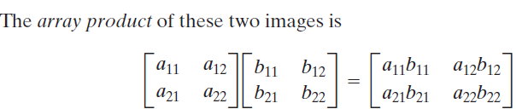
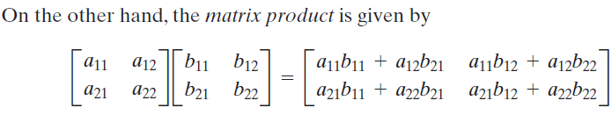
Array versus Matrix Operations

Slide 3

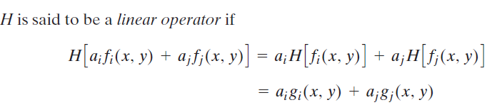
Linear versus Nonlinear Operations
Consider a general operator, H, that produces an output image, g(x, y), for a given input image, f (x, y):

Slide 4
Linear versus Nonlinear Operations
Equation (2.6-2) indicates that the output of a linear operation due to the sum of two inputs is the same as performing the operation on the inputs individually and then summing the results. – Additivity Property
In addition, the output of a linear operation to a constant times an input is the same as the output of the operation due to the original input multiplied by that constant. – Homogeneity Property

Slide 5
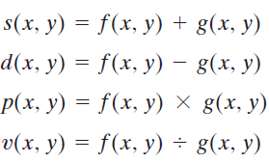
Arithmetic Operations

Slide 6
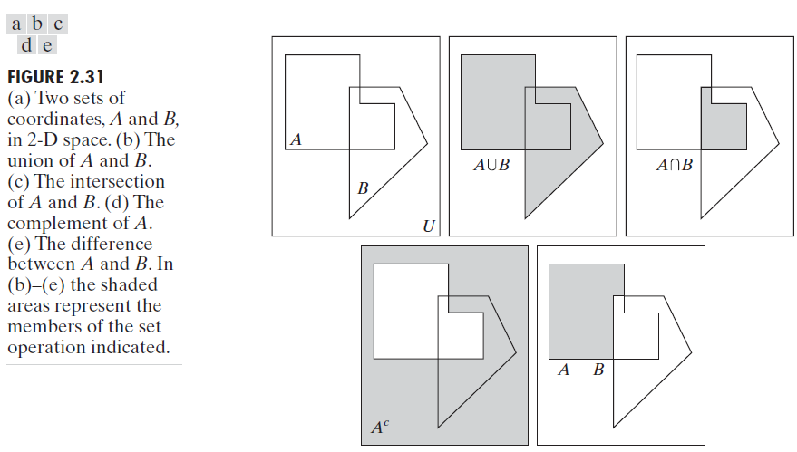
Set Operations

Slide 7
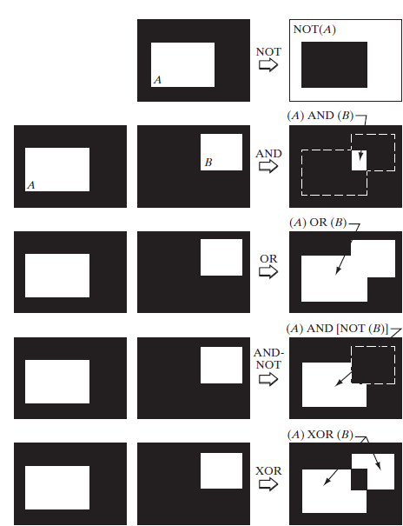
Logical Operations

